Slide 1


Slide 2
About today…
File handling
Reading from file
Writing to file
Error handling

Slide 3


Slide 4

Introduction
Definition
Manipulation of files, such as reading from or writing to them, using PHP scripts
Importance
Enables developers to manage data persistence, handle user uploads, log application
activities, and interact with external resources
Overview
PHP provides functions like fopen(), fread(), fwrite(), and fclose() for file operations

Slide 5

Reading from file
Opening a file using fopen() :
Example: $file = fopen('data.txt', 'r');
Checking file existence with file_exists() :
Example: if (file_exists('data.txt')) { /* Proceed with reading */ }
Reading file contents using fread(), fgets(), and file_get_contents() :
using fread()
$content = fread($file, filesize('data.txt'));
using fgets()
$line = fgets($file);
using file_get_contents()
$content = file_get_contents('data.txt');
Closing a file with fclose():
Example: fclose($file);

Slide 6
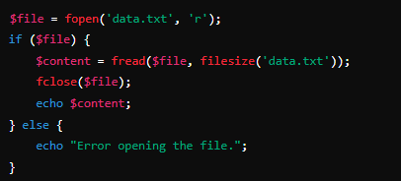

Example : Reading from file

Slide 7

Writing to file
Opening a file for writing using fopen() :
Example: $file = fopen('output.txt', 'w');
Writing content to a file using fwrite() :
Example: fwrite($file, 'Hello, World!');
Appending content to a file using 'a' mode :
Example: $file = fopen('log.txt', 'a'); fwrite($file, 'New log entry\n');
Truncating a file using 'w' mode :
Example: $file = fopen('data.txt', 'w');
fwrite($file, 'New content');

Slide 8
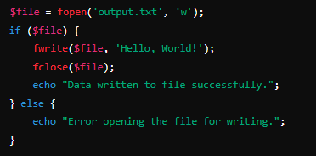

Example : Writing to a file

Slide 9


Slide 10

What PHP function is used to open a file for reading?
Which mode in the fopen() function is used to open a file for reading and writing, starting at the beginning of the file?
What function is used to read a file line by line in PHP?
Which function is used to write data to a file in PHP?

Slide 11

Task 1
Create a PHP script that opens a text file, reads its contents, and displays them on the webpage
Task 2
Develop a PHP script that accepts user input (e.g., a message) through a form and appends this input to a text file

